Slide 1
Complete the flow chart using these words:
Weathering
Erosion
Mechanical/Physical
Chemical
Wind
Waves
Gravity
Glaciers

Slide 2
Do Now:
Breakdown of rock in place!!
Shapes the land
Movement of the broken down “stuff” (rocks, dirt, etc.)
Acid Rain
Wind
Chemical Weathering
Oxidation/Rust
Water
Frost Action
Gravity
Physical Weathering
Root Wedging
Glaciers

Slide 3
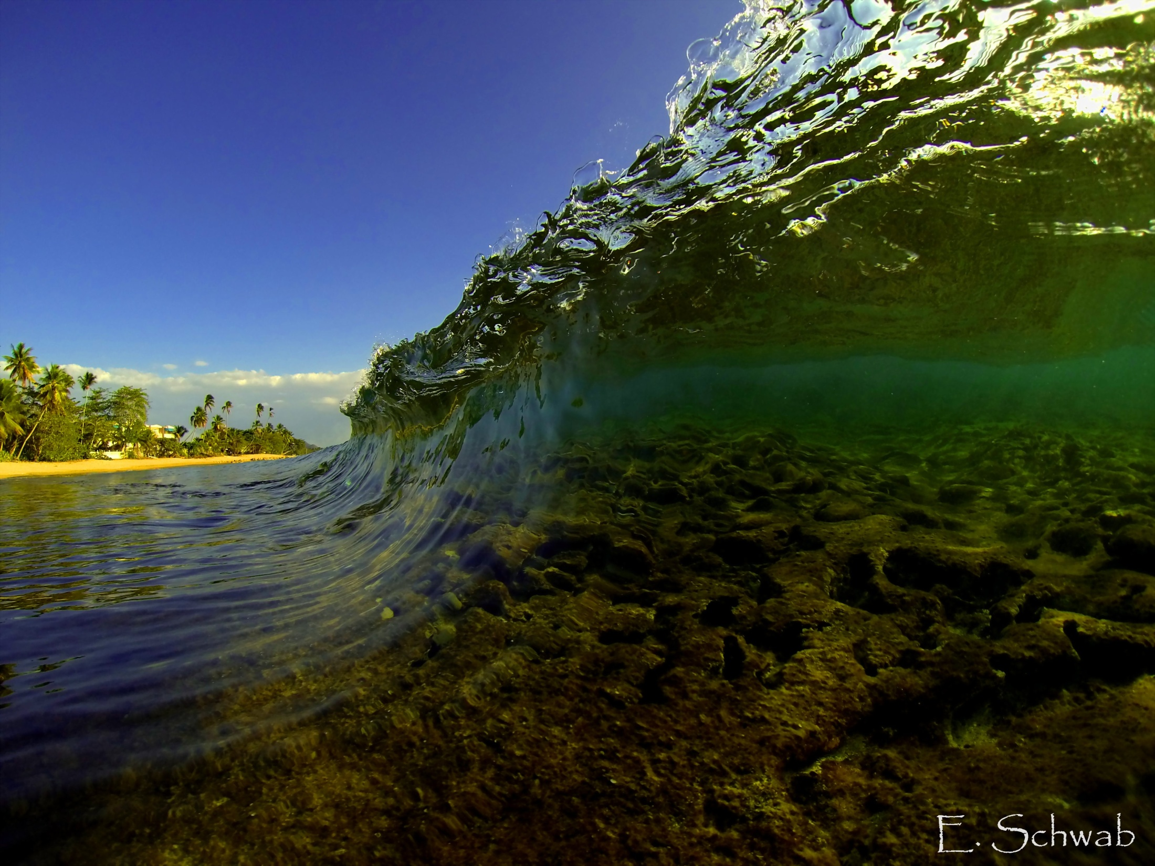
Wave Action

Slide 4
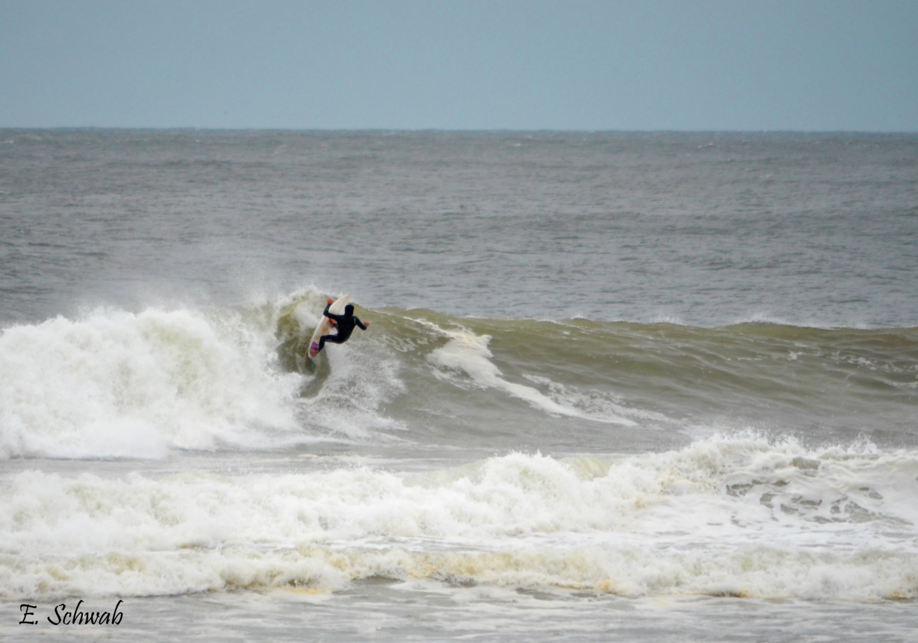
Waves can be fun…

Slide 5
Waves can be beautiful…

Slide 6
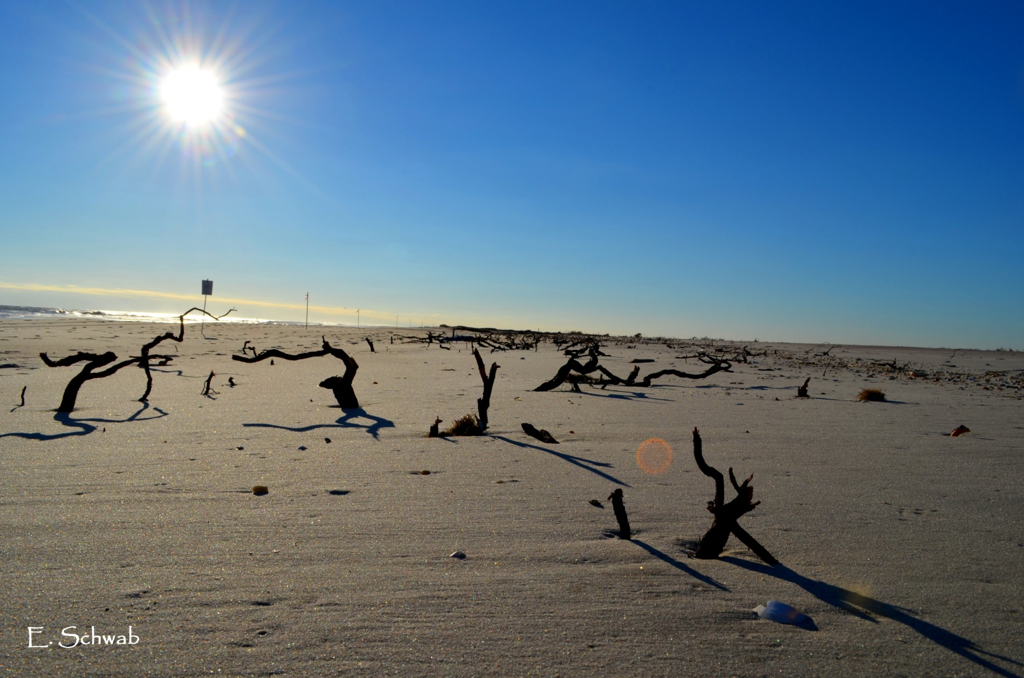
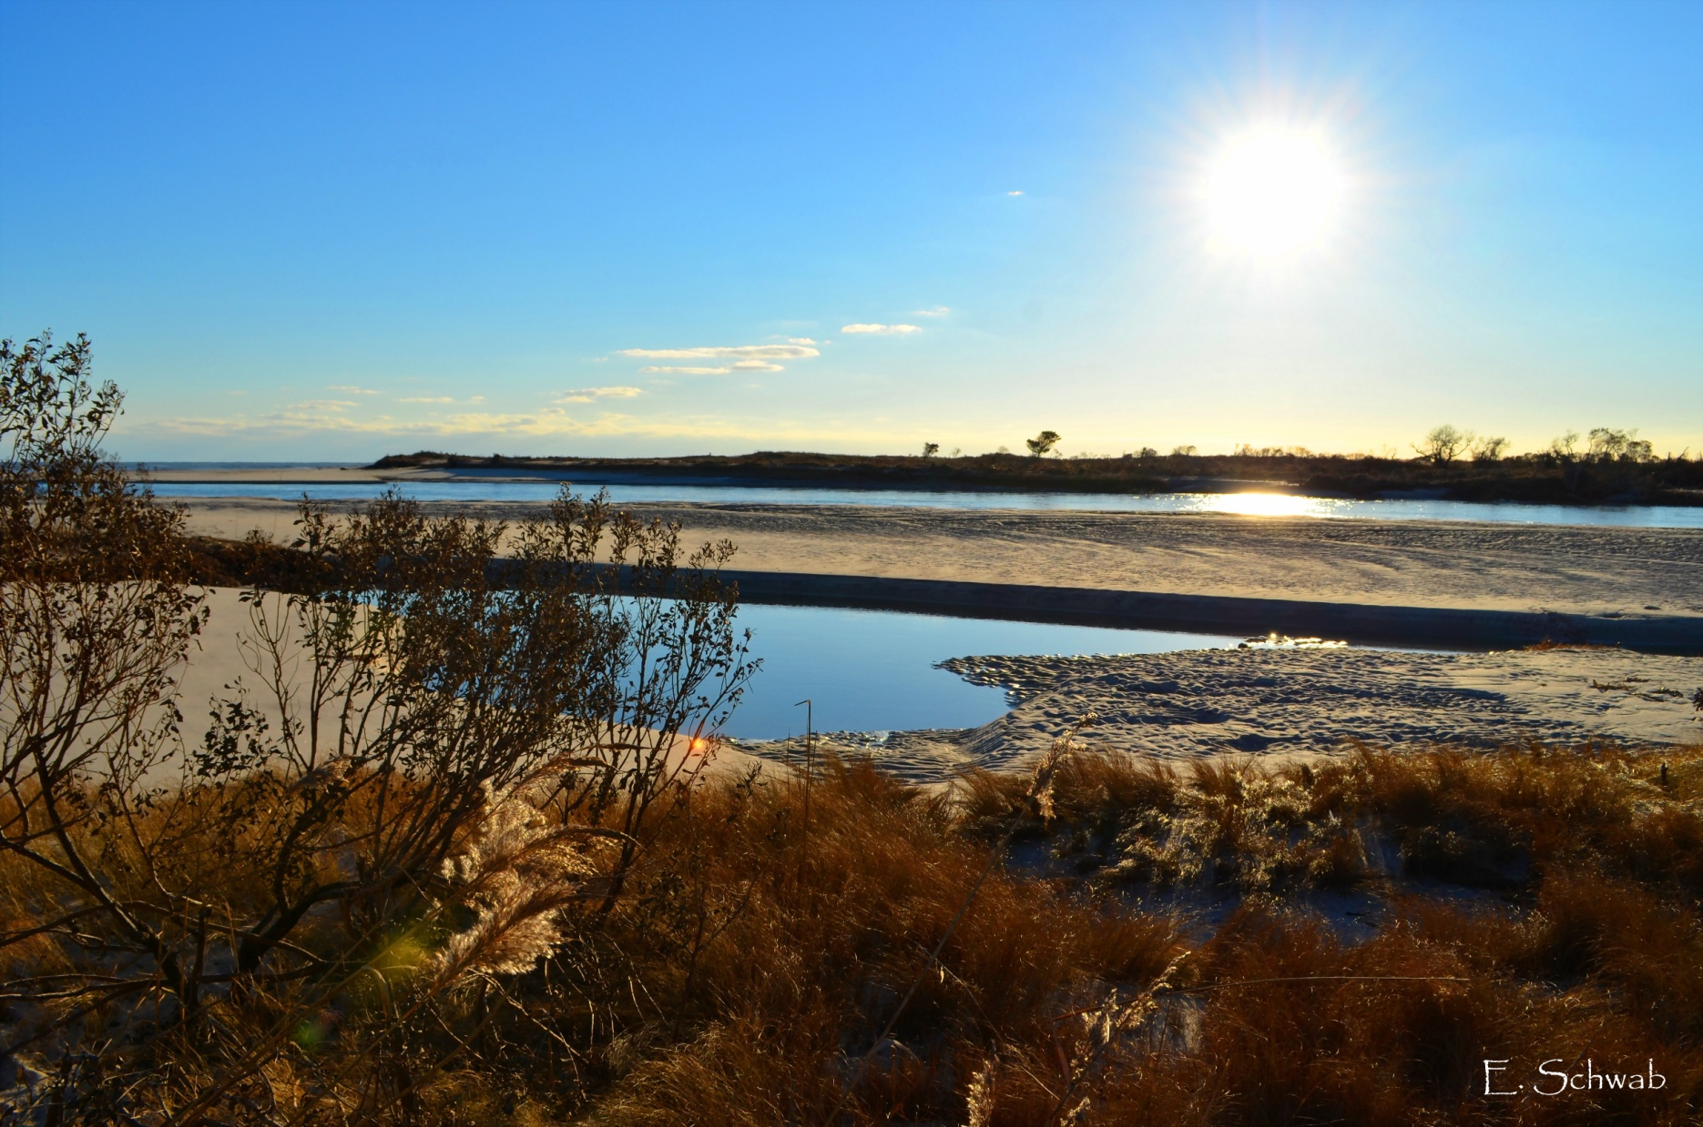
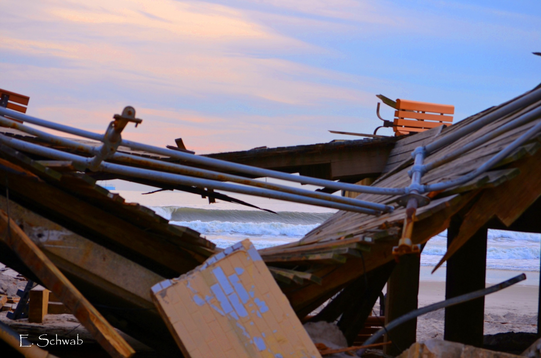
Waves can also cause destruction…
“New Inlet” on Fire Island as a result of Hurricane Sandy –11/14/12

Slide 7
How do waves work?
Where lakes and oceans meet land, waves and currents act as agents of erosion
As a wave approach the shore it drags upon the bottom
-The wave becomes unstable and “breaks”

Slide 8
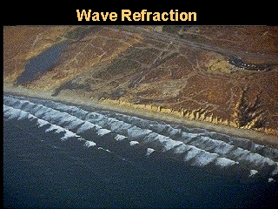
Waves and Currents
As waves approach the shore a great amount of energy is released
Usually waves approach at an angle

Slide 9
Waves and Currents
Water comes in at one angle and leaves in at another creating a zigzag pattern
This zigzag pattern cause a flow of water along the beach called a long shore current

Slide 10
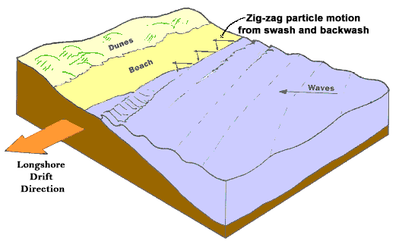
Longshore Current

Slide 11
Waves and Currents
The waves constantly hit the shore and erode the sand while the long shore current moves the sand down the beach

