Slide 1
Mapping 8th Grade General Science See also KT Topography!!

Slide 2
Latitude & Longitude
Notes packet
p. 22 – What is Latitude Do Now/HW
p. 23 – What is Longitude Do Now/HW
p. 24 – Plotting Latitude and Longitude
©Mark Place, 2008-2009
www.LearnEarthScience.com

Slide 3
Latitude and Longitude is the coordinate system used to locate any point on Earth.
(example: GPS)
How is latitude measured?

Slide 4
What are Latitude lines?
Latitude lines are parallel to the
Equator

Slide 5
The Equator is the Zero degree line of Latitude :
How is latitude measured?
and
of the
North
South
Equator

Slide 6
Latitude is measured
and
from the
North
South
Equator

Slide 7
180
165
150
135
120
105
90
75
60
45
30
15
0
15
30
45
60
75
90
105
120
135
150
165
180
90
80
E
70
North
60
50
40
30
F
20
10
0
G
10
South
20
30
40
50
60
H
70
80
90

Slide 8
180
165
150
135
120
105
90
75
60
45
30
15
0
15
30
45
60
75
90
105
120
135
150
165
180
90
To get to the next line of
latitude, you must move
in which of two directions?
80
E
70
60
50
40
30
Latitude
F
Equator
20
10
0
G
10
20
30
40
50
60
H
70
80
90

Slide 9
What are Longitude Lines?
Longitude lines connect
the North Pole
to the South Pole
They are NOT
Parallel to each other!

Slide 10
The Prime Meridian is the 0 degree line of longitude
Longitude is measured
and
of the
East
West
Prime Meridian

Slide 11
Longitude
180
165
150
135
120
105
90
75
60
45
30
15
0
15
30
45
60
75
90
105
120
135
150
165
180
90
80
E
70
60
To get to the next line of
longitude, you must move
in which of two directions?
50
40
30
F
20
10
0
G
10
20
30
40
50
60
H
70
80
Prime Meridian
90

Slide 12
180
165
150
135
120
105
90
75
60
45
30
15
0
15
30
45
60
75
90
105
120
135
150
165
180
90
80
E
70
60
50
40
30
F
West
East
20
10
0
G
10
20
30
40
50
60
H
70
80
90

Slide 13
Let’s do some plotting.

Slide 14
On the coordinate system, plot the coordinates given in your notes:
180
165
150
135
120
105
90
75
60
45
30
15
0
15
30
45
60
75
90
105
120
135
150
165
180
90
80
E
70
D
60
A
50
40
30
F
20
10
0
G
B
10
20
30
C
40
50
60
H
70
80
90

Slide 15
State the coordinates for each of the letters in the figure above:
180
165
150
135
120
105
90
75
60
45
30
15
0
15
30
45
60
75
90
105
120
135
150
165
180
90
20°N, 75°E
80
E
70
60
65°N, 50°W
50
40
F
30
20
10
0
G
10
70°S, 15°E
20
30
10°S, 135°W
40
50
H
60
70
80
90

Slide 16
LONGITUDE
Notes page 20
BASED ON EARTH’S
ROTATION

Slide 17
LONGITUDE
EACH HOUR,
EARTH ROTATES
15°
(360°/24hrs)

Slide 18
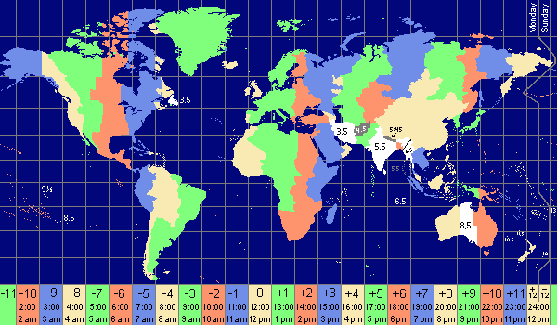
HOW MANY TIME ZONES?

Slide 19
HOW MANY TIME ZONES?
24 TIME ZONES
15° APART

Slide 20
People on the
same line of
longitude have
the same
Local Time

Slide 21
Example: Two students record a
difference in local time of two
hours. How many degrees of
longitude apart are they?
15° x 2 hours = 30°

Slide 22
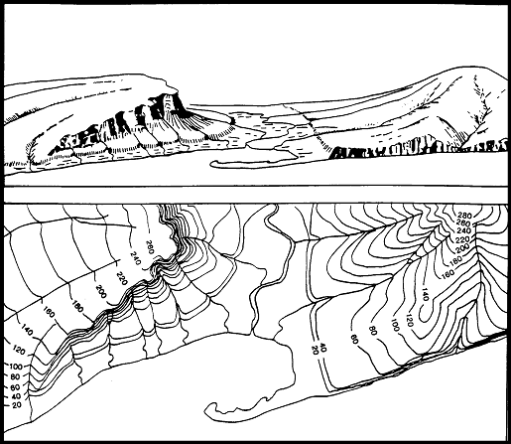
Topography / Contour Maps
Elevation of the land (hills and valleys)

Slide 23
What is the purpose?
To show the Elevation of the land (hills and valleys) above and below sea level

Slide 24
Who uses topographic maps?
the military
miners
police
farmers

Slide 25
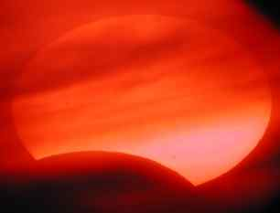
When might someone
use a topographic
map?
building homes
plan a hiking trip
landscaping
road building

Slide 26
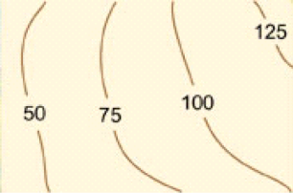
Map 1 Practice
Contour Interval?
25
X

Slide 27
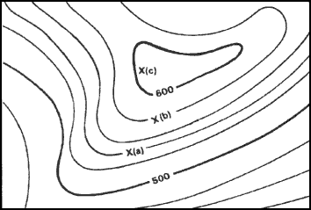
Contour
Interval?
20
Elevation of "A"?
540
Elevation of "B"?
580

Slide 28
Lines close together =
STEEP SLOPE
Lines far apart =
Gentle SLOPE
Highest possible elevation?
619

Slide 29
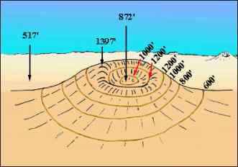
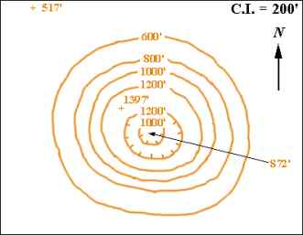
What do hachured
lines show?
areas of
depression

Slide 30
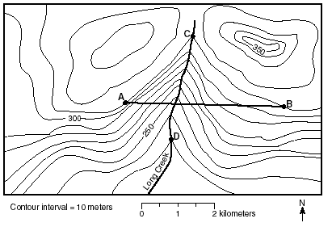
If north is at the
top of the page, what direction
is this river flowing?
south

Slide 31
Can a river flow north?
yes!

Slide 32
Name two ways that you can
determine which
way a river flows
on a topographic map.
contour lines point
upstream
rivers flow
downhill

Slide 33
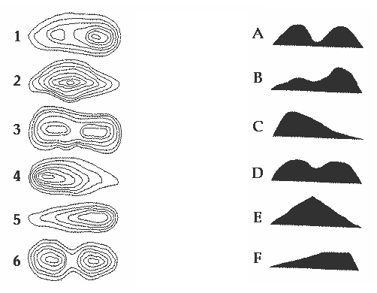
Please match the contour map on the left with the profile on the right.

