Slide 1
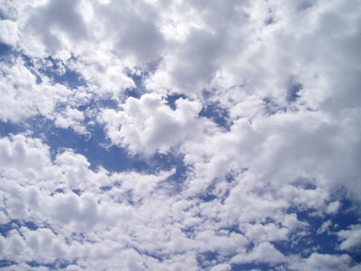
GENERAL SCIENCE
UNIT 4
WEATHER AND CLIMATE

Slide 2
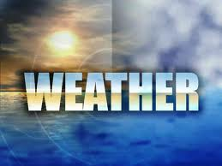
What is weather?
Weather – is the daily conditions of the atmosphere.

Slide 3
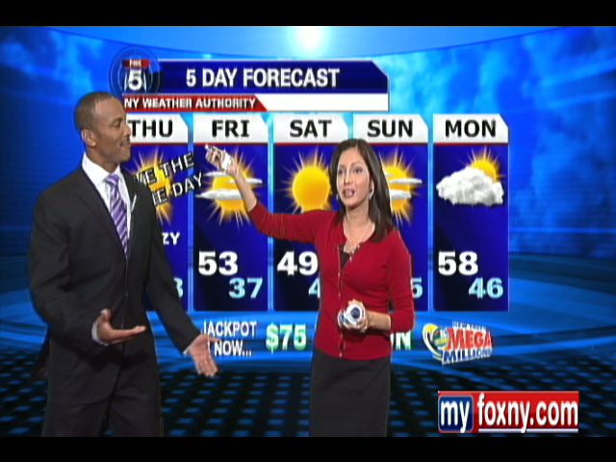
The study of weather is called Meteorology

Slide 4
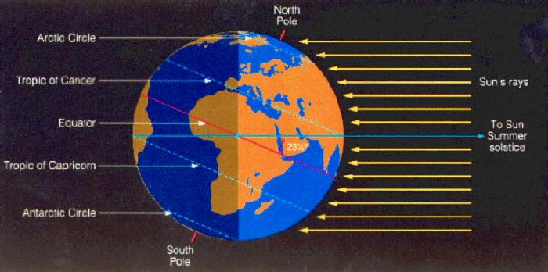
Weather is caused by the uneven heating of Earth’s surface

Slide 5
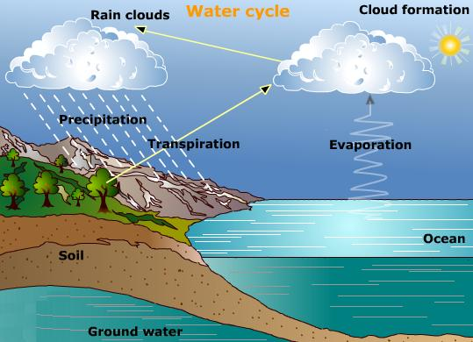
The Water Cycle
Water is constantly being cycled between the atmosphere, the ocean and land.

Slide 6
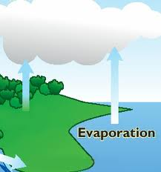
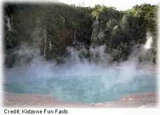
Evaporation
Is when the sun heats up water in rivers or lakes or the ocean and turns it into vapor or steam.
“Water (liquid) turns into water vapor (gas)”

Slide 7
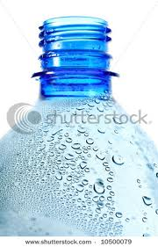
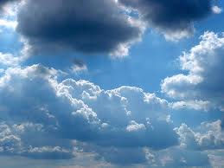
Condensation
Happens when water vapor in the air gets cold and changes back into liquid, forming clouds.
THIS IS WHY WE
GET CLOUDS!!

Slide 8
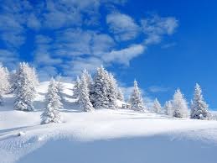
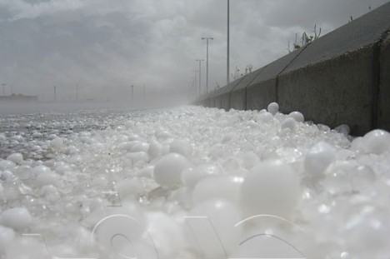
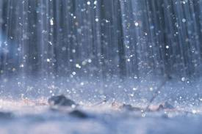
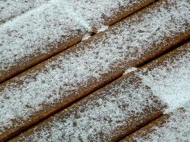
Precipitation
Occurs when so much water has condensed that the air cannot hold it anymore. The clouds get heavy and water falls back to the earth in the form of rain, hail, sleet or snow.

Slide 9
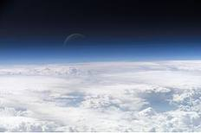
What is the atmosphere?
Atmosphere – is all the gases (Air) that surrounds planet Earth.

Slide 10
Weather Balloon To Space

Slide 11
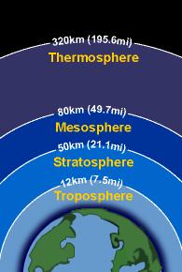
Layers of the Atmosphere

Slide 12
Layers of the Atmosphere
Troposphere
Closest to the ground
All weather happens here
This is air you breathe
Temperature decrease
Pressure decreases

Slide 13
Layers of the Atmosphere
Stratosphere
Ozone EXTRA
Ozone is inside this layer
Ozone – layer of oxygen gas that absorbs the suns radiation
Temperature increases
Pressure decreases

Slide 14
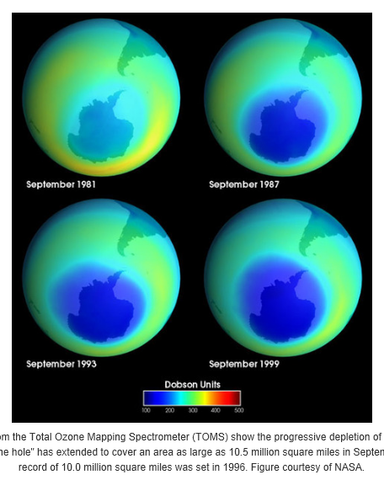
Ozone Depletion Images
Ozone Website

Slide 15
Layers of the Atmosphere
Mesosphere
Meteors burn up in this layer
Temperature decreases
Pressure decreases

Slide 16
Layers of the Atmosphere
Thermosphere
Last layer of air before entering space
Temperature increases
Pressure decreases

Slide 17
The Atmosphere
As you increase your altitude (Height off the ground):
    AIR PRESSURE DECREASES
    AIR TEMPERATURE DECREASES in the Troposphere

Slide 18
The Atmosphere
Air Pressure – the amount of force the atmosphere is pushing down on you.
Temperature – the amount of heat in the atmosphere

Slide 19
HEAT TRANSFER
Heat can move from one object to another in
3 different ways.
1. CONDUCTION
2. CONVECTION
3. RADIATION

Slide 20
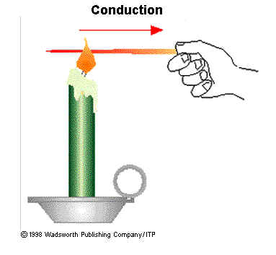
HEAT TRANSFER
CONDUCTION – the movement of heat through solid materials that are physically touching.

Slide 21
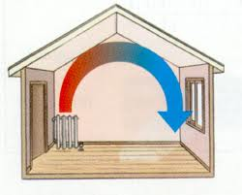
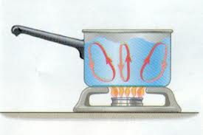
HEAT TRANSFER
CONVECTION – the movement of heat through liquids and gases.
HOT Liquids / Gases – RISE
COLD Liquids / Gases - SINK

Slide 22
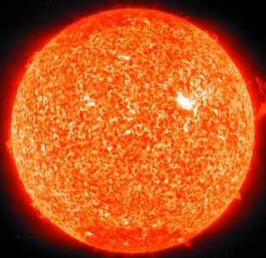
HEAT TRANSFER
RADIATION – the movement of heat through electromagnetic waves.

Slide 23
What is wind?
The movement of air caused by differences in air pressure
Differences in AIR PRESSURE are caused by differences in air TEMPERATURE
8 hours of wind https://www.youtube.com/watch?v=d-_q-md80VQ

Slide 24
Two types of Winds
GLOBAL Winds: Wind that is constantly blowing in certain directions on different parts of the earth
Ex. The Jet stream always moves across the United States from West to East and determines a lot of New York’s weather patterns.
In the US, all weather moves towards the Northeast

Slide 25
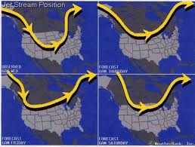

Slide 26
Local Winds
Local winds move short distances and can blow from any direction. They are caused by the geography of the area.
Ex. Land Breezes and Sea Breezes

Slide 27
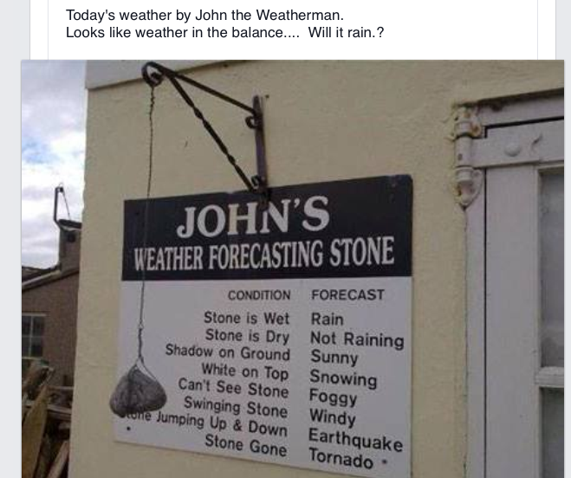

Slide 28
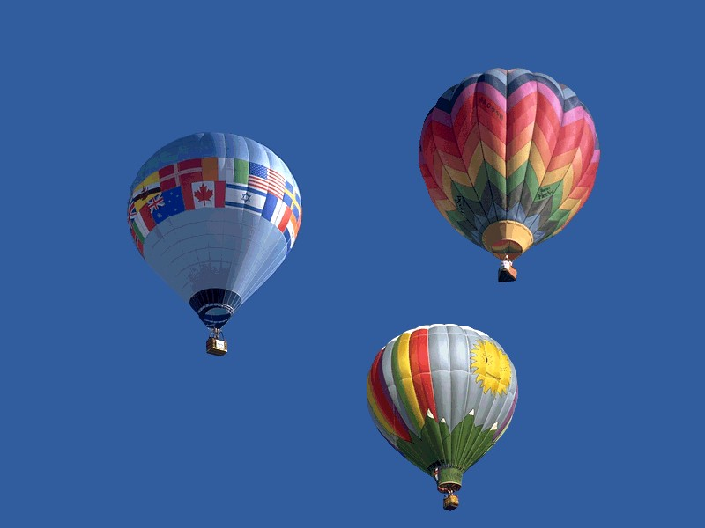
What do meteorologists observe to forecast the weather?
  Air Pressure – the force of the air pushing down on the surface

Slide 29
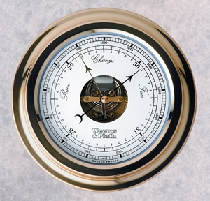
TOOL USED FOR AIR PRESSURE
Barometer – measures the amount of air pressure in the atmosphere
    Low pressure – stormy weather
    High pressure – clear skies

Slide 30
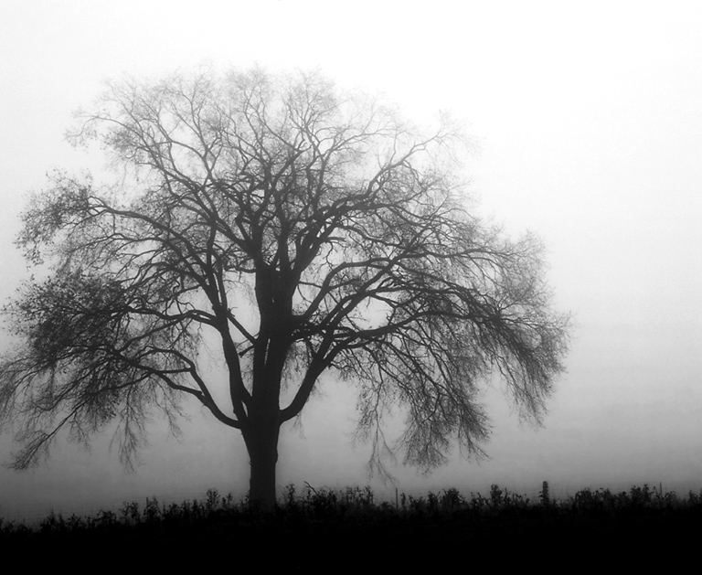
What do Meteorologists observe to forecast the weather?
Humidity – amount of water vapor the air is holding.

Slide 31
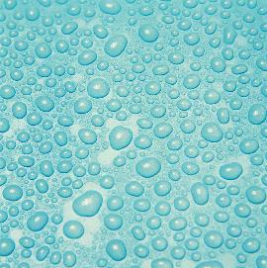
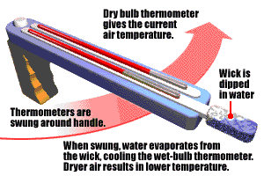
What do Meteorologists observe
to forecast the weather?
Dew point – the temperature when the water vapor will condense into a liquid
Sling Psychrometer is the tool used to measure Dew Point and Relative Humidity.

Slide 32
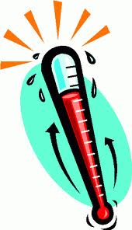
What do Meteorologists study to forecast the weather?
Temperature – amount of heat in the atmosphere
Thermometer is the tool used to measure temperature.

Slide 33
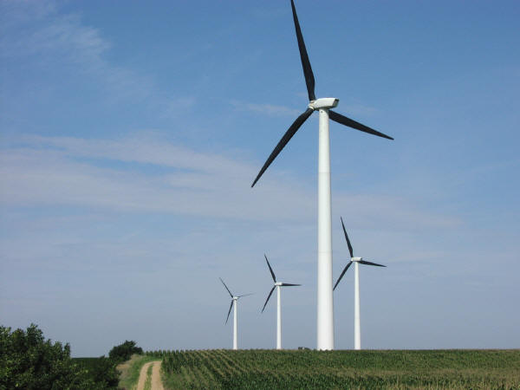
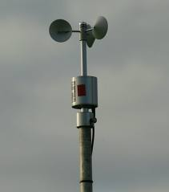
What do meteorologists observe
to forecast the weather?
Wind speed – how fast or slow the air is moving.
Anemometer is the tool used to measure WIND SPEED.

Slide 34
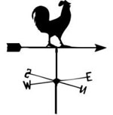
What do meteorologists observe
to forecast the weather?
Wind direction: Which compass direction the air is traveling.
The tool used to measure the wind direction is a WIND VANE.

Slide 35


MEMORIZE THIS:
Clouds form when warm air rises, expands and cools below its dewpoint temp.
That is why clouds are usually so high in the sky.

Slide 36
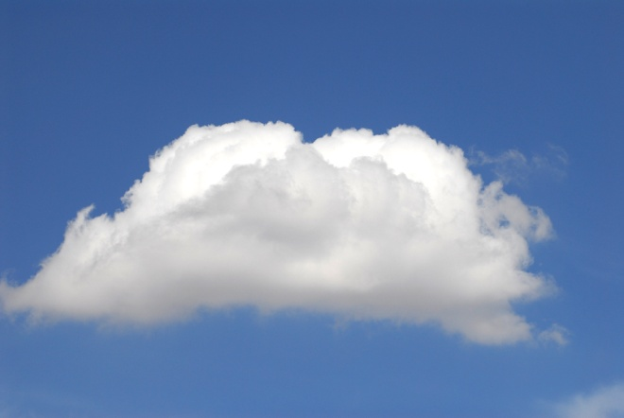
Types of Clouds:
Cumulus Clouds – puffy white clouds with flat bottoms.
Formed when warm air rises and generally mean fair weather.
When they get very large (cumulonimbus)– thunderstorms can occur

Slide 37
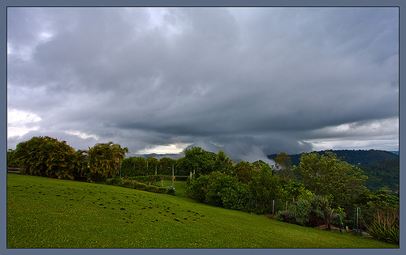
Stratus Clouds
Clouds that form in layers that cover large areas.
Often caused by gentle lifting of large body of air into the atmosphere.

Slide 38
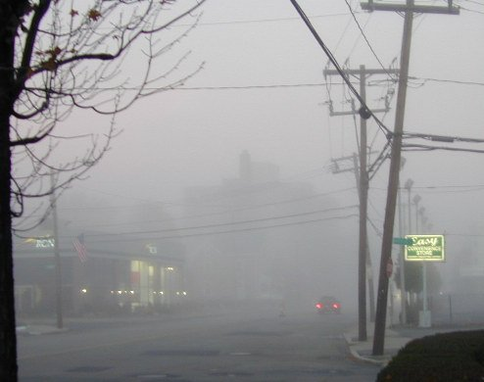
Fog
Stratus cloud that is formed near the ground.

Slide 39
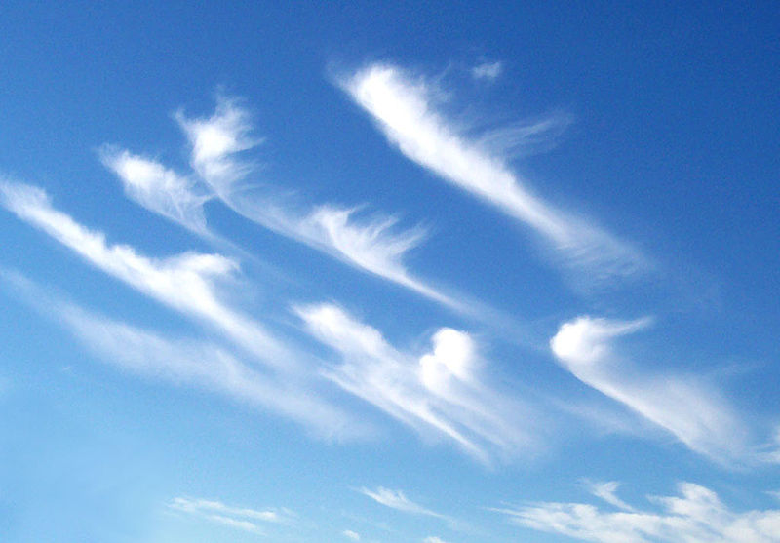
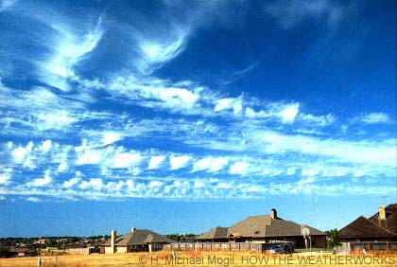
Cirrus Clouds
Thin, feathery white clouds found at high altitudes (made of ice crystals).
Formed when wind is strong.

Slide 40
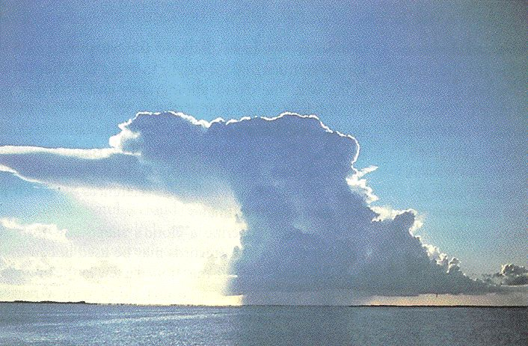
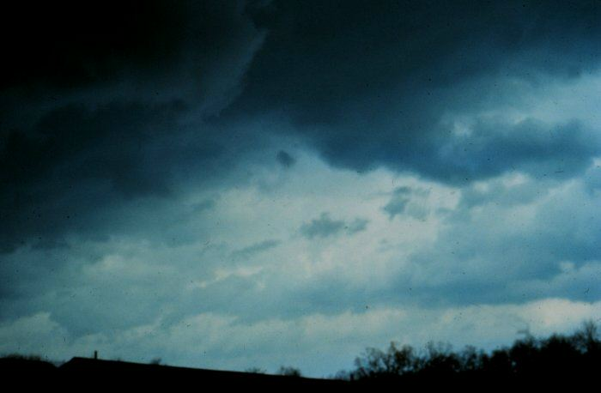
Storm clouds
Often have ‘nimbo’ or ‘nimbus’ as part of their names.
Ex: Cumulonimbus, Nimbostratus

Slide 41
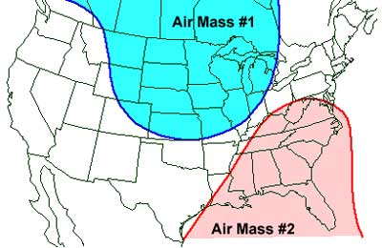
Air Masses are:
Huge bodies of air with similar moisture and temperatures

Slide 42
The characteristics of air masses come from their source region (where they form)
If they develop over water
(maritime) = MOIST
If they develop over land
(continental) = DRY
If they develop over cold areas
(polar) = COOL
If they develop over warm areas
(tropical) = WARM

Slide 43
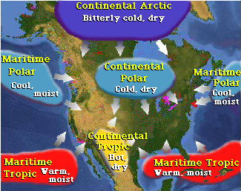

Slide 44
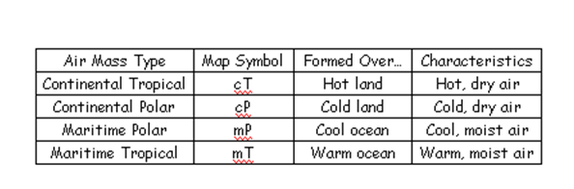
4 Types of Air Masses

Slide 45
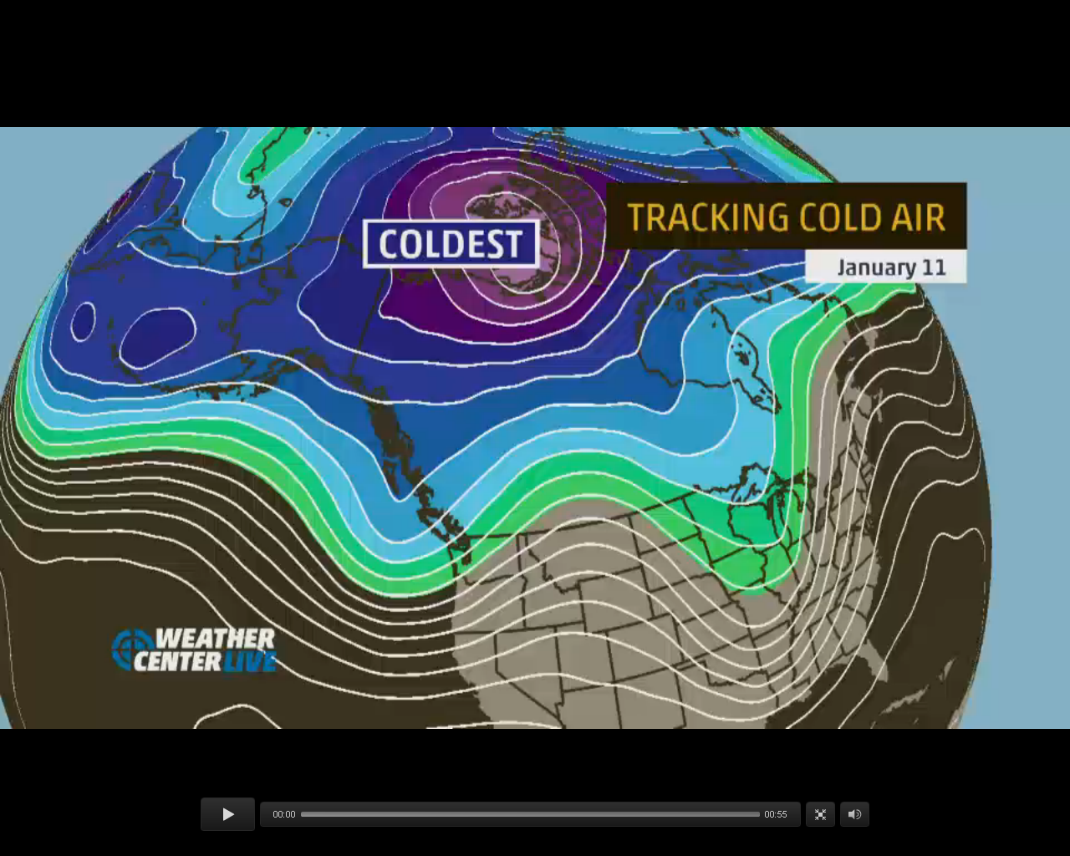

Slide 46
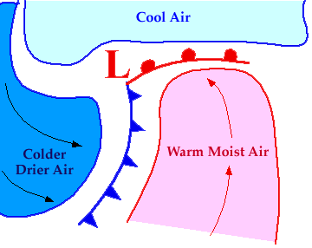
Fronts
Warm front
Cold front
The boundary between 2 air masses
***Fronts always bring bad weather

Slide 47

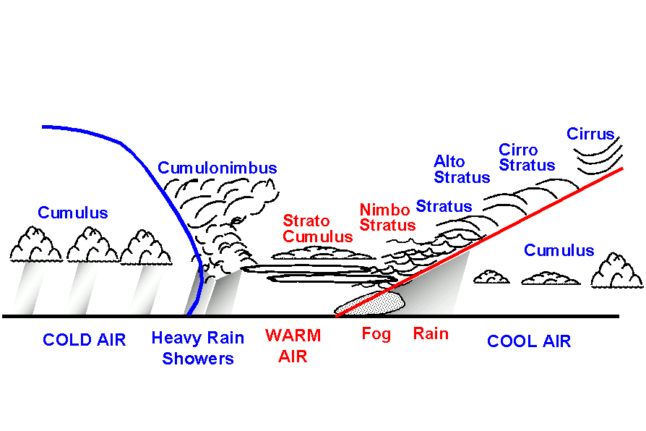
Warm Front
- Warm air rises gently over cold air because warm air is less dense
- Result = gentle, long-lasting precipitation, followed by humid, warm air

Slide 48

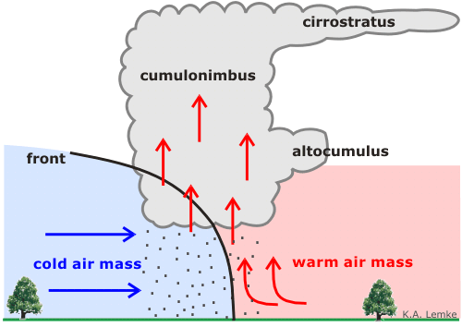
Cold Front
- Cold, fast-moving air meets warm air and forces it up quickly
- Result = Quick, violent storms followed by cool, dry air
Thunderclouds

Slide 49
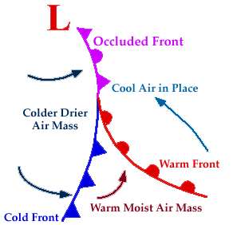
Occluded Front
- When a fast moving cold front overtakes a warm front.
- Result = precipitation

Slide 50

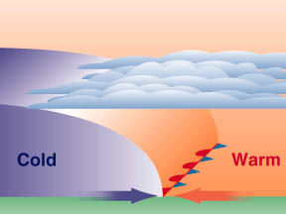
Stationary Front
- When a warm air mass and cold air mass meet and neither is moving
- Result = long periods of precipitation

Slide 51
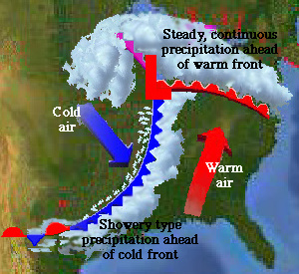
Forecasting Weather
click for US Current Weather Map

Slide 52
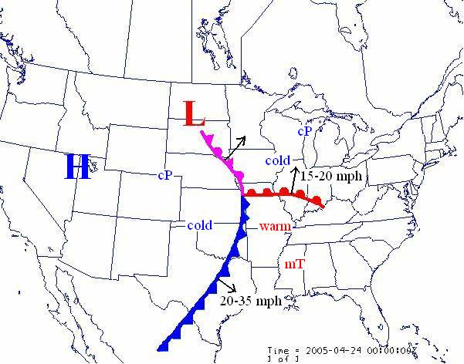
http://www.wunderground.com/maps/

Slide 53
Severe Weather Notes

Slide 54

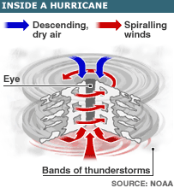


Severe Weather
Hurricanes
Tornadoes

Slide 55

All Hurricanes are low pressure storm systems

Slide 56
What makes a hurricane different from a tornado?
Hurricanes
Form over warm water
Last a long time
Hit a large area
Most of the damage comes from the storm surge
Occur in late summer and early fall
Tornadoes
Form when cP and mT air masses meet over land (most often)
Short-lived
Cover a small area
Most of the damage comes from the winds
(can be over 300 mph!)
Occur in spring and early summer

Slide 57
Thunderstorms
Intense weather systems that produce:
  Strong winds
  Heavy rain
  Lightning and thunder
Occur along cold fronts
Cumulonimbus clouds - storm clouds

Slide 58
When do Thunderstorms occur?
Two atmospheric conditions required for thunderstorms
1- Moist warm air near the Earth’s surface
2- Unstable atmosphere cold air surrounding a rising air mass)

Slide 59
Lightning
An electric discharge that occurs between a positively charged area and a negatively charged area
Can occur:
  Cloud to cloud
  Cloud to earth
  In the same cloud

Slide 60
Thunder
The sound that results from rapid movement of air along a lightning strike
Occurs during Thunderstorms
Lightning first – then thunder because light travels faster than sound.

Slide 61
Tornado
Is a small, spinning column of air that has high wind speed with low pressure that touches the ground
Wind moving in 2 directions cause the air to spin with cloud, creating a funnel
When funnel cloud touches the surface, it is now a tornado
Winds- 120+ km/hr (up to 300 MPH)

Slide 62
Hurricanes
A large rotating, tropical weather system with wind speeds of at least 120 km/h
Most powerful storms on earth
Form over warm, tropical oceans
Category 1-5
Storm surge and flooding in coastal areas
    LIKE LONG ISLAND’S SOUTH SHORE!!!!!
  Superstorm Sandy video compilation
    http://safeshare.tv/w/zJfQSoqhMN

Slide 63
Hurricane formation
Thunderstorms over tropical oceans meet with winds in different directions
Spin counter clockwise in Northern Hemisphere and clockwise in the southern due to the Coriolus Effect (Spin of earth)
Warm moist air fuels hurricanes Must have LOW pressure
Hurricanes die once they move over colder water or land

Slide 64
Blizzards
Huge winter storms with high winds, heavy snow and sometimes lightning and thunder.
Ice storms can occur as rainfall begins to freeze and can disrupt electric and phone service.
Can cause power outages and dangerous travel conditions. Frostbite and hypothermia.

Slide 65
Severe Weather Safety
Listen to the radio/TV during storm for information
Lightning is attracted to tall objects if outside stay away from trees or lay down if in the open
Stay out of bodies of water during a storm

Slide 66
Climate Change
Scientists around the world believe that the Earth’s temperature is gradually increasing.
Global warming – is the name for the gradual increase of average temperatures worldwide.
Scientists believe that an increase in CO₂ emissions is causing the temperature to rise.

Slide 67
Average Yearly Temperature
Global Warming in 15 seconds - video

Slide 68
What causes Global Warming?
When Carbon Dioxide CO₂ is trapped in the atmosphere, it causes the
  GREENHOUSE EFFECT
Water Vapor and Carbon Dioxide in the atmosphere trap heat and don’t let it escape into space.
“These greenhouse gases act like a blanket”

Slide 69
What human activities cause excess CO₂ (Global Warming)
Breathing
Burning Fossil Fuels
  such as coal, oil, gas
Deforestation (cutting down trees that use up CO₂ when they photosynthesize)

Slide 70
What effect does Global Warming have on the earth?
Melting Ice Caps in the Arctic and Antarctic which cause rising sea levels
Plants/trees growing season is affected
Animals like polar bears have to relocate due to loss of ice (habitat)
Ocean waters are warmer causing large cylconic (hurricanes) storms and death to some sea life.

Slide 71
How can we reduce CO₂ emissions?
Burn less fossil fuels (NON-RENEWABLE)
  Use less electricity (shut off lights, unplug appliances, buy energy efficient appliances)
  Use less fuel (gas for cars) by carpooling, taking public transportation, smaller cars
Use Renewable sources of energy
  Use solar energy to produce electricity
  Use wind energy to produce electricity
  Use water energy (dams) to produce electricity
  Use geothermal energy to heat our homes

